Slide 1
Sentimental Analysis on Amazon product Reviews
PRODUCT: ALEXA ECHO DOT (3RD GEN)

Slide 2
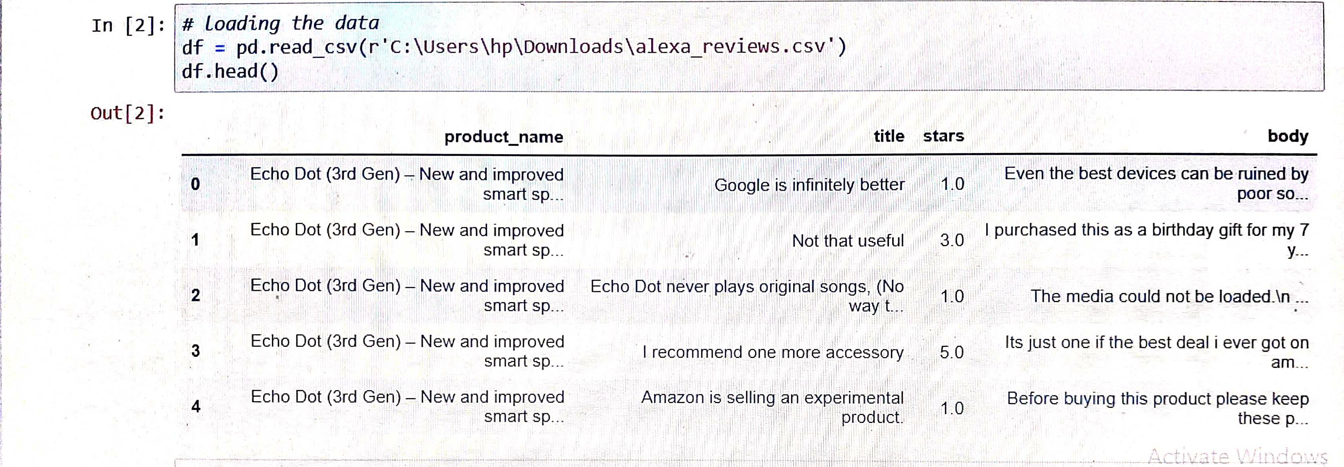
Data Extraction
Reviews Collected: 4.2k Reviews

Slide 3
Analysis of Ratings given by Customers
Ratings | No. of Customers
5 | 2361
4 | 759
3 | 572
2 | 375
1 | 223

Slide 4
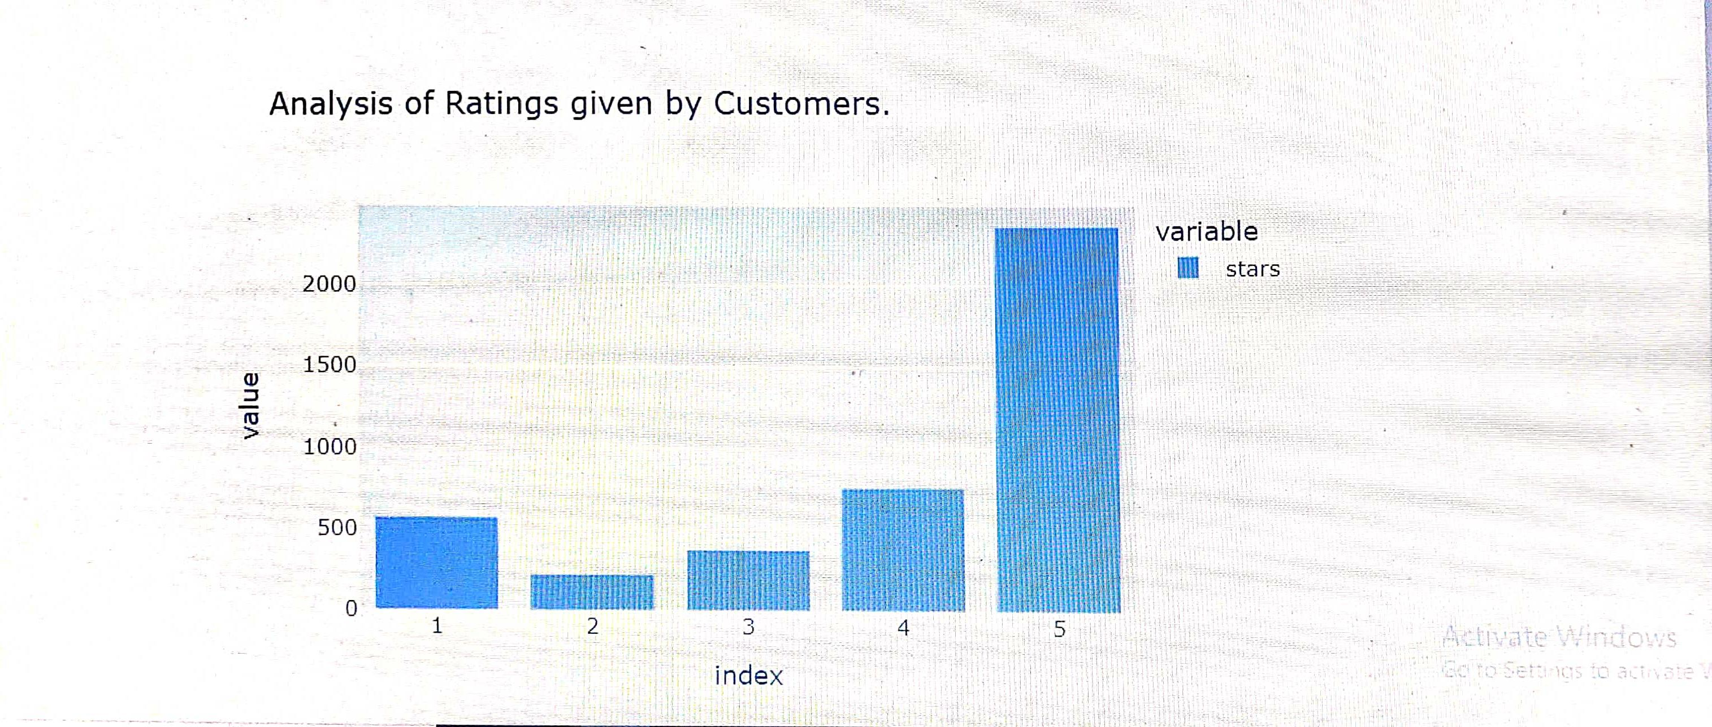

Slide 5
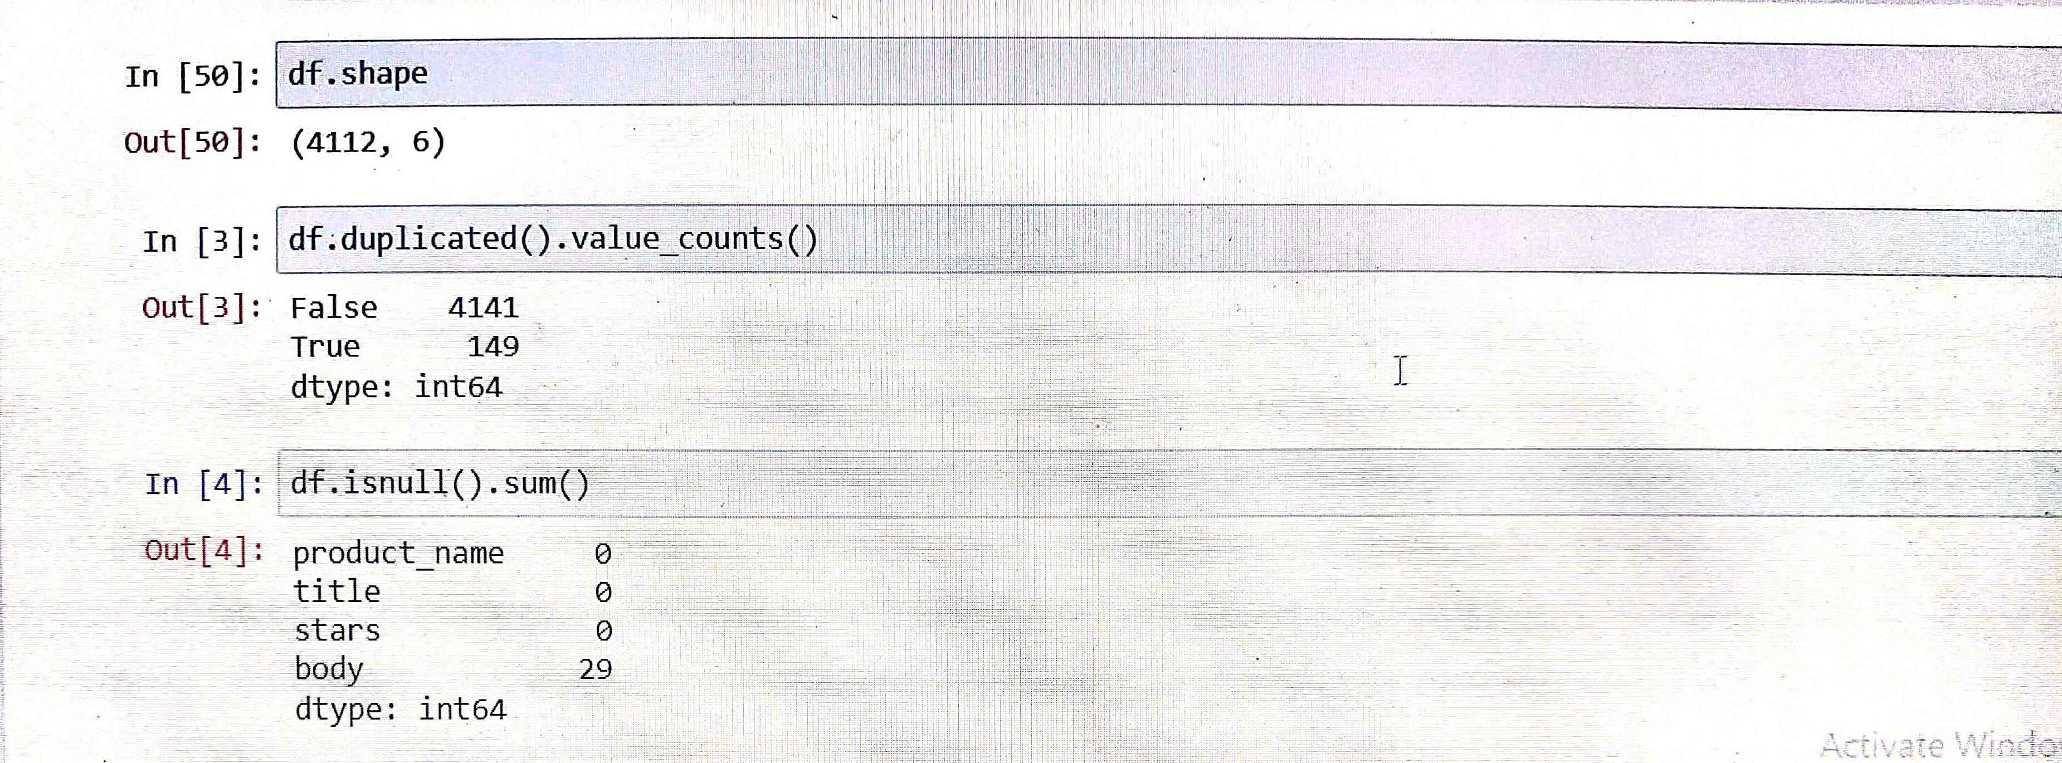
Exploratory Data Analysis
Shape: The data frame contains 4112 rows and 6 columns.
Duplicated values: Data frame contains 149 duplicated values.
Null values: The body column In the data frame contains 29 null values

Slide 6
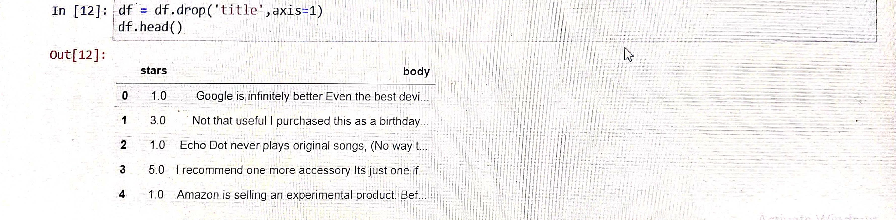
Data Preprocessing
Removing duplicate values from the data frame.
Dropping out all the null values from the data frame.
Making a separate data frame with the columns containing stars and body.

Slide 7
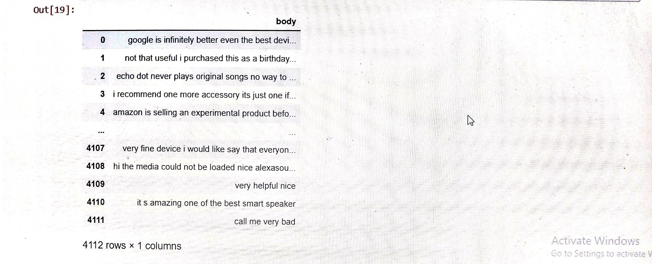
Functions of Text Preprocessing :
→ Converts the text into lower case characters.
→ Removes user name
→ Removes hyperlink
→ Removes special characters
→ Removes extra space
After applying all the above functionalities the data frames looks like

Slide 8
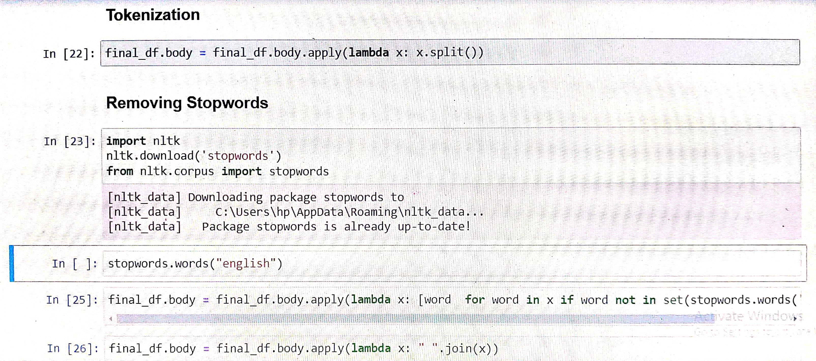
Tokenization:
Tokenization helps in interpreting the meaning of the text by analyzing the sequence of the words.
Removing Stopwords:
Stop words are the most commonly occuring words which are not relevant in the context of the data and do not contribute any deeper meaning to the phrase.

Slide 9
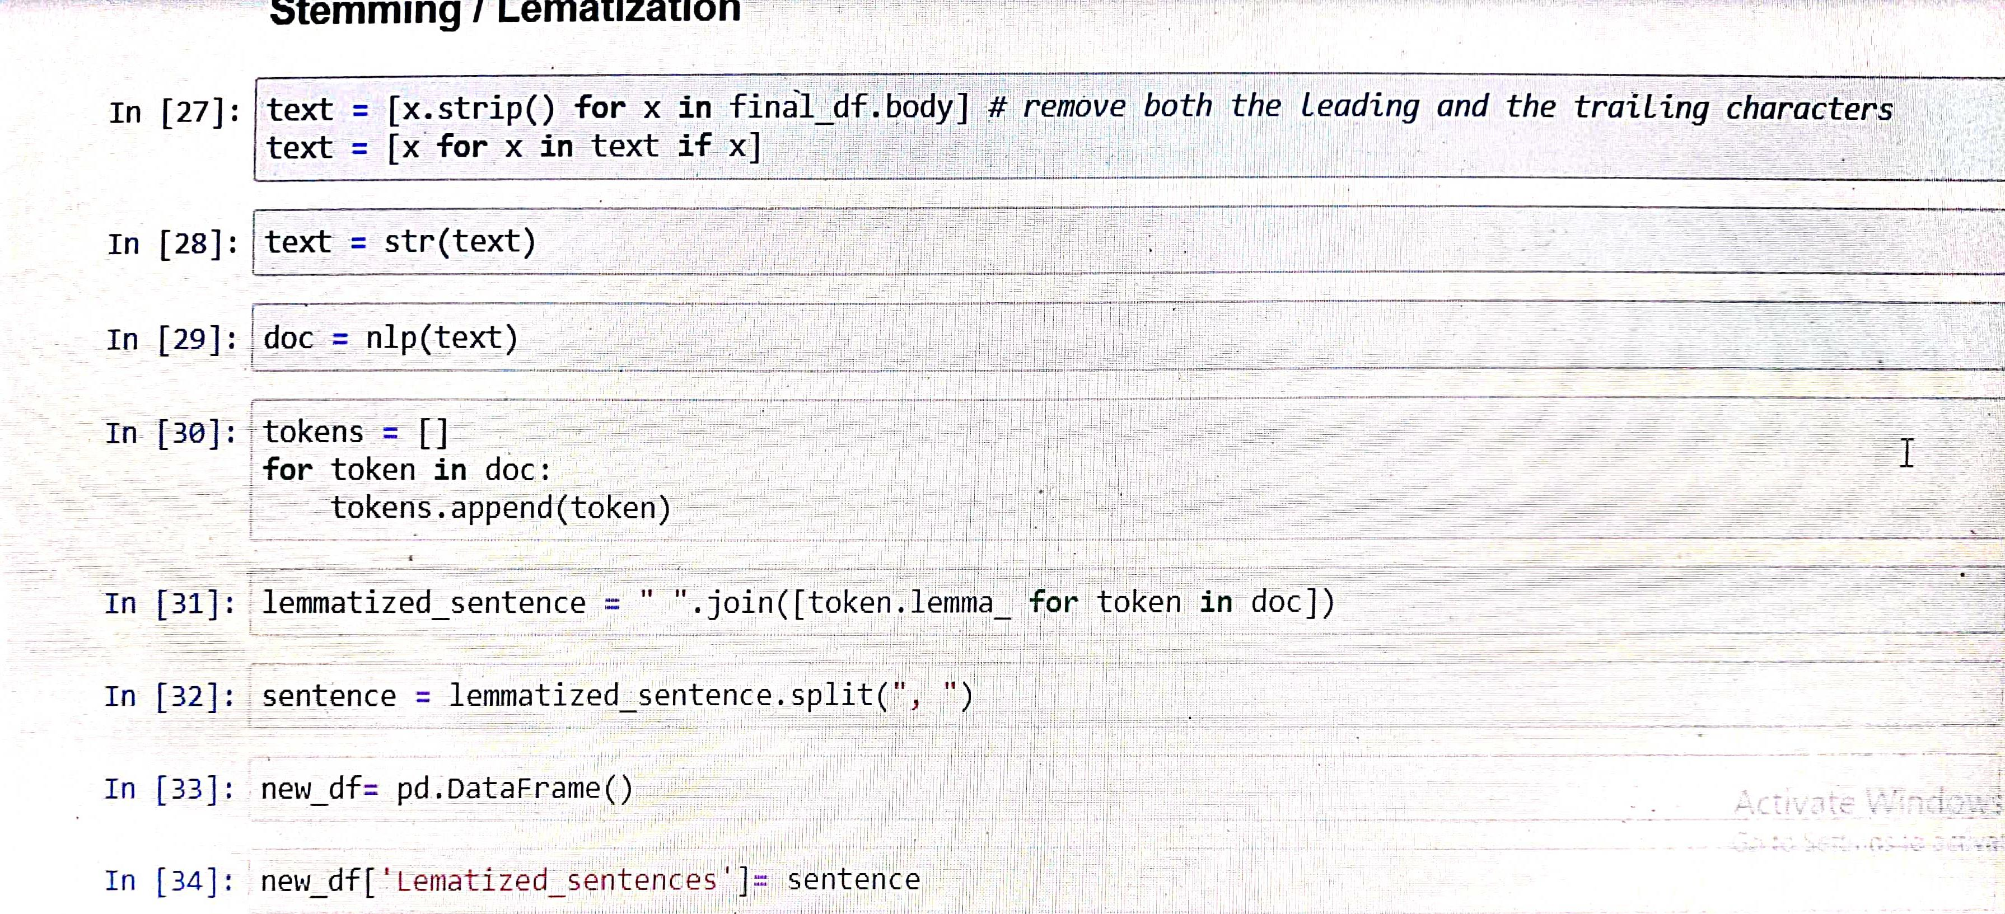
Stemming and Lemmatization:
Stemming and lemmatization are methods used to analyze the meaning behind a word. Stemming uses the stem of the word, while lemmatization uses the context in which the word is being used.

Slide 10
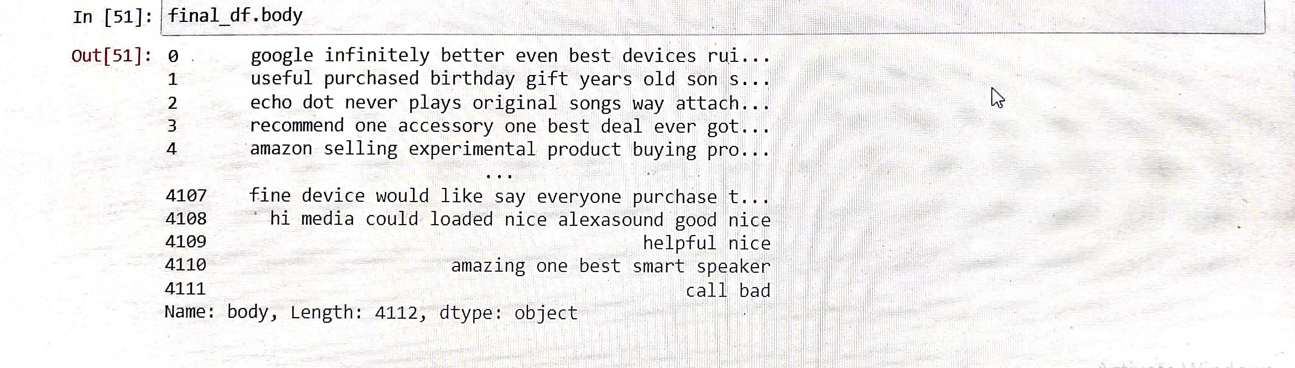
After the Data Preprocessing the data frame looks like

Slide 11
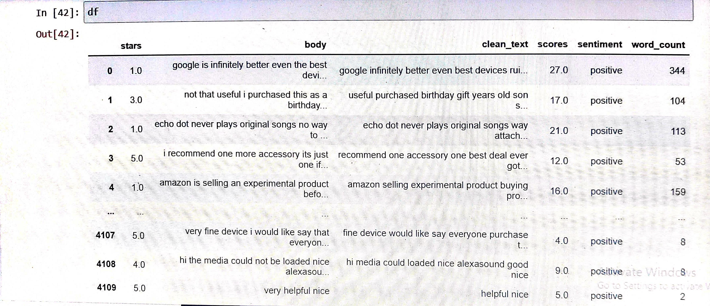
Sentimental Analysis using Affin
Affin: It contains 3300+ words with a polarity score associated with each word.
Sentimental Analysis on text data looks like

Slide 12
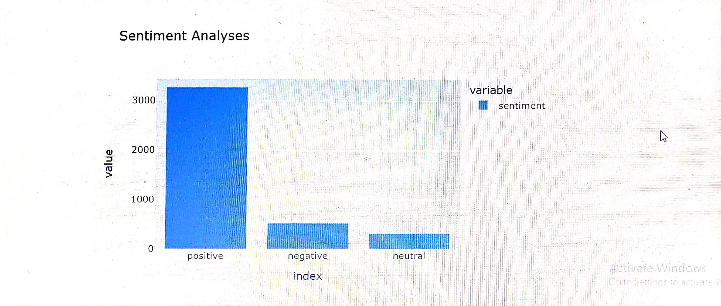
Sentimental Analysis using Bar plot
Type of Sentiment | No. of Reviews
Positive | 3264
Negative | 527
Neutral | 321

Slide 13
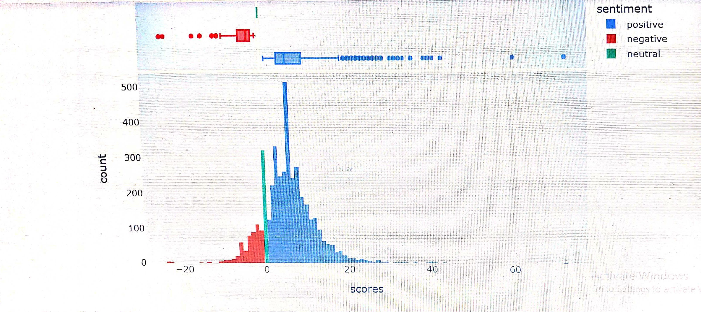
Distribution of Scores using Histogram

Slide 14
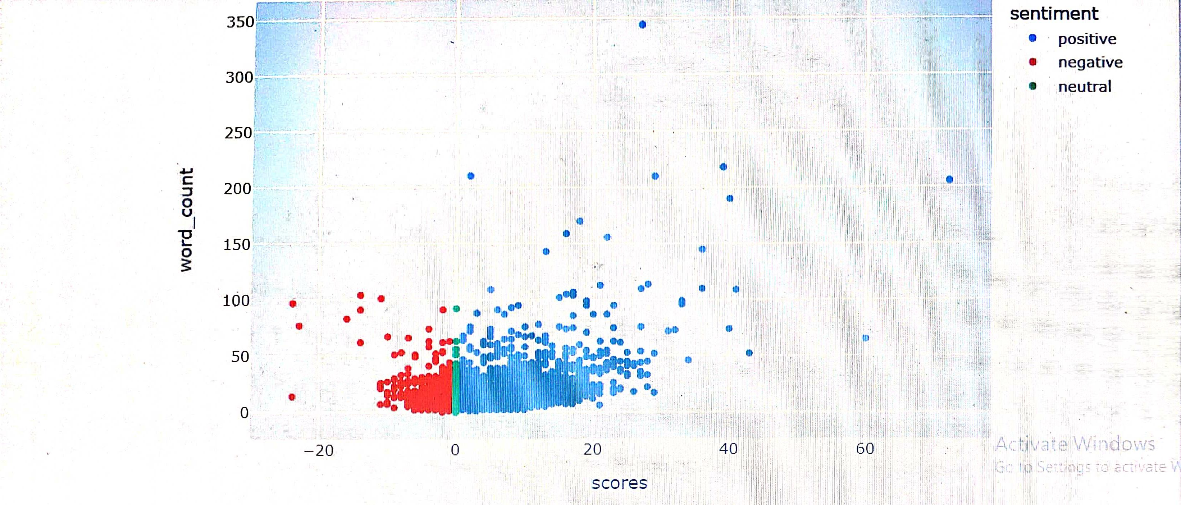
Scores vs Word Count

Slide 15
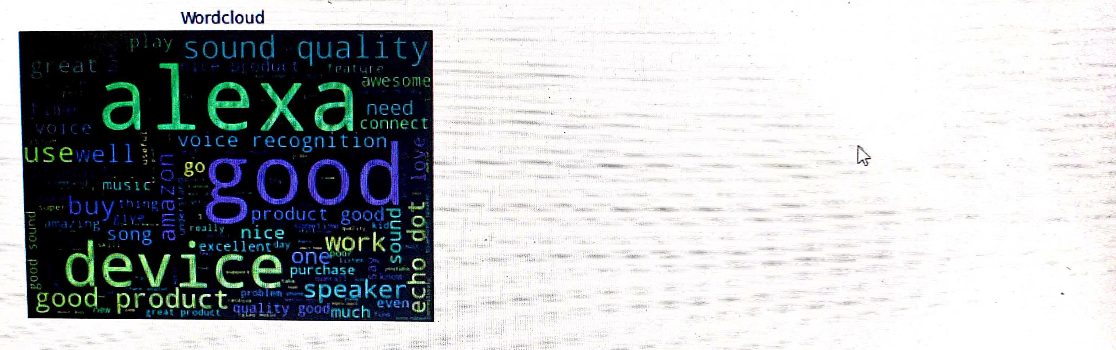
Word Cloud
A word cloud (also known as a tag cloud or text cloud) is a visual representation of a text, in which the words appear bigger the more often they are mentioned.

Slide 16
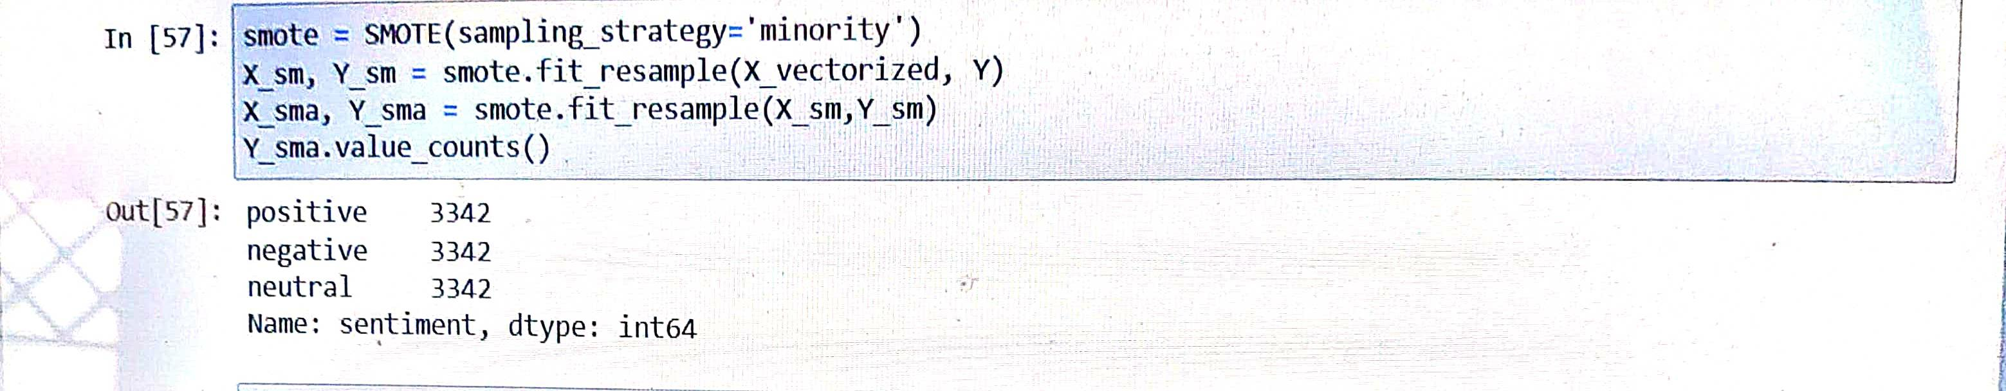
Data Balancing using SMOTE

Slide 17
Data Before Balancing
Data After Balancing
Type of Sentiment | No. of Reviews
Positive | 3264
Negative | 527
Neutral | 321
Type of Sentiment | No. of Reviews
Positive | 3342
Negative | 3342
Neutral | 3342

Slide 18
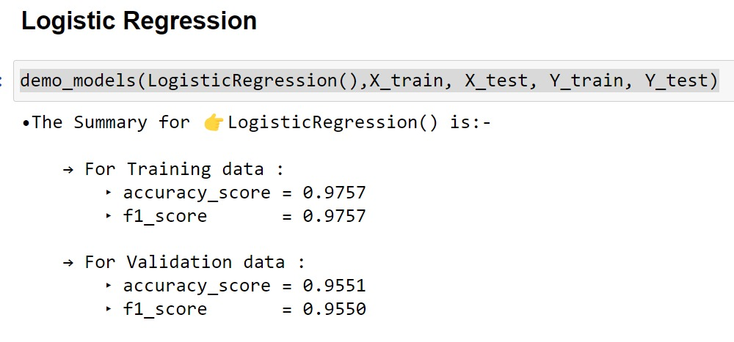
Model Building
Logistic regression is a Supervised Machine Learning algorithm. It is used for predicting the categorical dependent variable using a given set of independent variables. Therefore the outcome must be a categorical or discrete value.

Slide 19
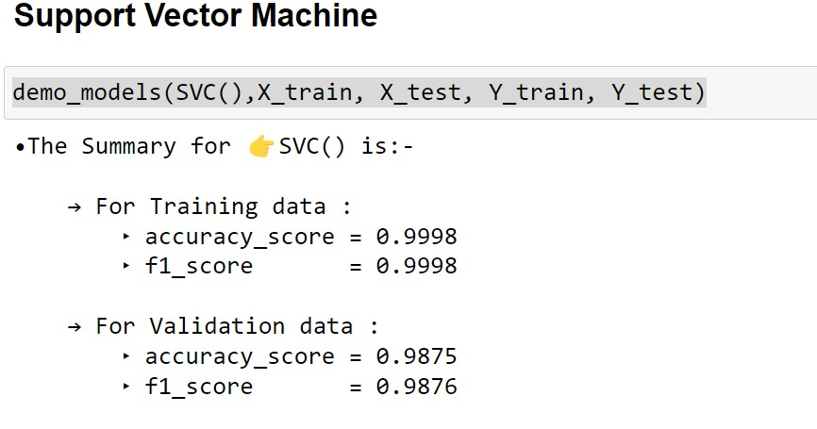
Support Vector Machine” (SVM) is a supervised machine learning algorithm that can be used for both classification or regression challenges.
The objective of the support vector machine algorithm is to find a hyperplane in an N-dimensional space(N — the number of features) that distinctly classifies the data points.

Slide 20
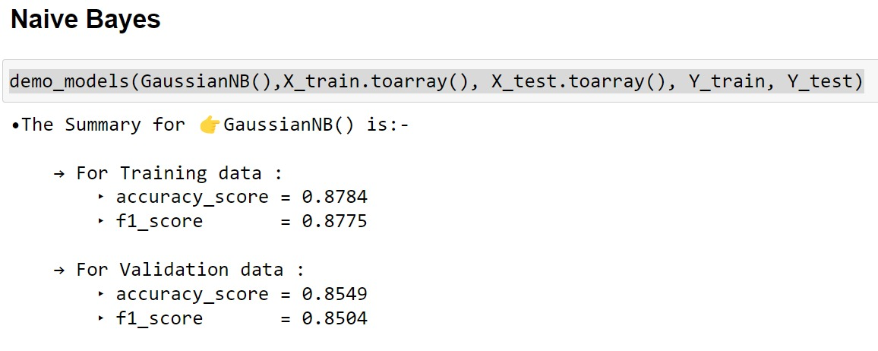
Naïve Bayes algorithm is a supervised learning algorithm, which is based on Bayes theorem. It is a probabilistic classifier, which means it predicts on the basis of the probability of an object.
Some popular examples of Naïve Bayes Algorithm are spam filtration, Sentimental analysis, and classifying articles.

Slide 21
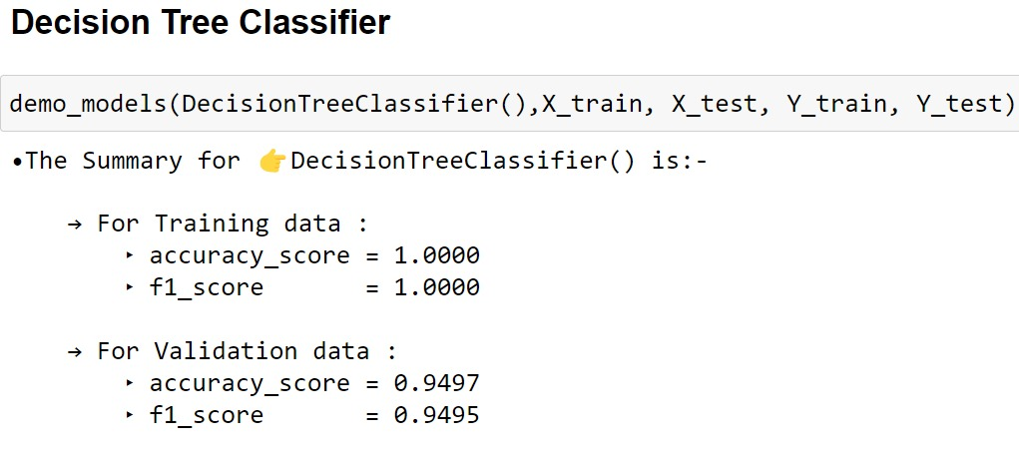
Decision Tree is a Supervised learning technique that can be used for both classification and Regression problems.
It is a tree-structured classifier, where internal nodes represent the features of a dataset, branches represent the decision rules and each leaf node represents the outcome.

Slide 22
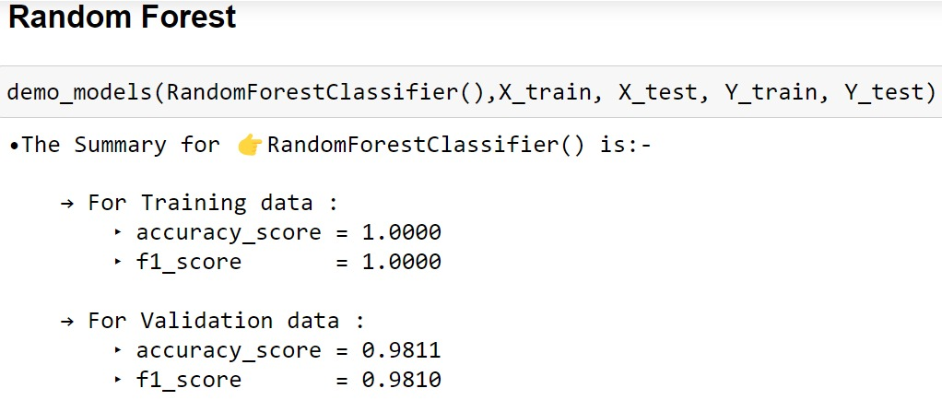
Random forest is a Supervised Machine Learning Algorithm that is used widely in Classification and Regression problems. It builds decision trees on different samples and takes their majority vote for classification and average in case of regression.

Slide 23
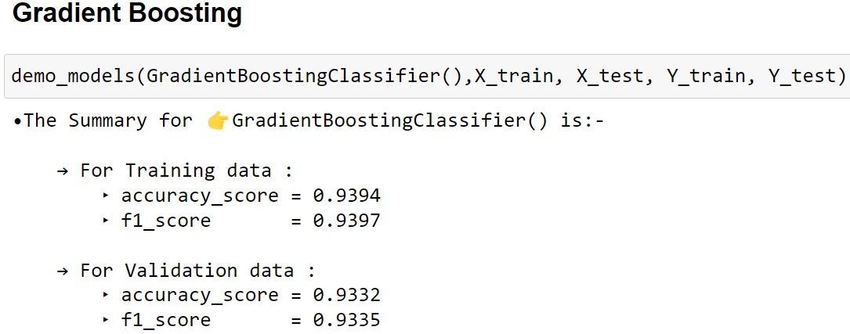
Gradient Boosting is a popular boosting algorithm. In gradient boosting, each predictor corrects its predecessor’s error it is generally used when we want to decrease the Bias error.
It relies on the intuition that the best possible next model, when combined with previous models, minimizes the overall prediction error.

Slide 24
Model | Training Data |  | Testing Data
 | F1-Score | Accuracy | F1-Score | Accuracy
Logistic Regression | 0.9757 | 0.9757 | 0.9550 | 0.9551
SVM | 0.9998 | 0.9998 | 0.9876 | 0.9875
Naïve Bayes | 0.8775 | 0.8784 | 0.8504 | 0.8549
Decision Tree | 1.0000 | 1.0000 | 0.9495 | 0.9497
Random Forest | 1.0000 | 1.0000 | 0.9811 | 0.9810
Gradient Boosting | 0.9397 | 0.9394 | 0.9335 | 0.9332

Slide 25
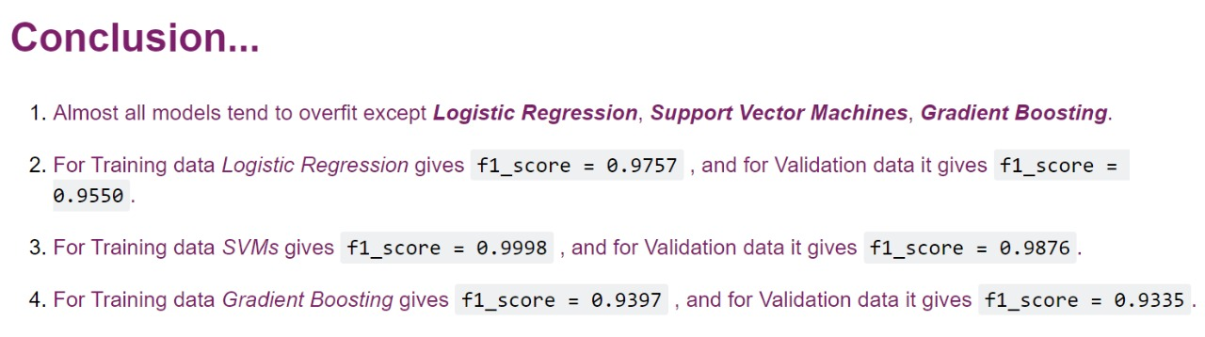
Conclusion

Slide 26
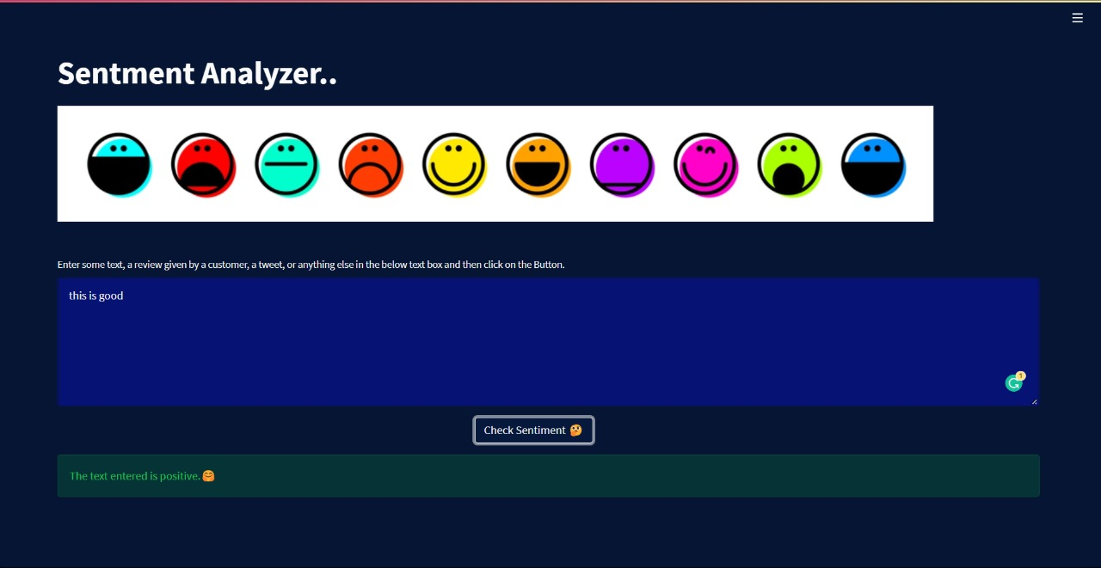
Model Deployment

Slide 27
Thank you

